Slide 1
Dinosaur: Create the Template Page
Download ‘mod6’ and unzip
Open ‘index.html’ and ‘styles.css’ in text editor
Fix title; add link to ‘styles’ in ‘index’
<!doctype html>
<html lang="en">
<head>
<meta charset="utf-8">
<title>Your_Name Dinosaur Assignment</title>
</head>
<!doctype html>
<html lang="en">
<head>
<meta charset="utf-8">
<title>Steve Johnson Dinosaur Assignment</title>
<link href="css/styles.css" rel="stylesheet">
</head>
1

Slide 2



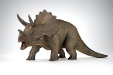

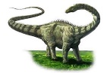
Dinosaur: Create the Template Page
Use ‘styles.css’ to hold our styling
css
js
images
index.html
styles.css
<link href="css/styles.css" rel="stylesheet">
2

Slide 3
Dinosaur: Create the Template Page
Write the style for <body>
@charset "utf-8";
/* CSS Document */
body {
background: #fbf5de;
background-image: url('../images/hfootprint.png');
background-repeat: repeat-x;
}
@charset "utf-8";
/* CSS Document */
3

Slide 4
Dinosaur: Create the Template Page
Go to fonts.google.com
Find ‘Ga Maamli’ and ‘Get font’
Get the Embed Code; copy 3 links into <head> of index
4

Slide 5
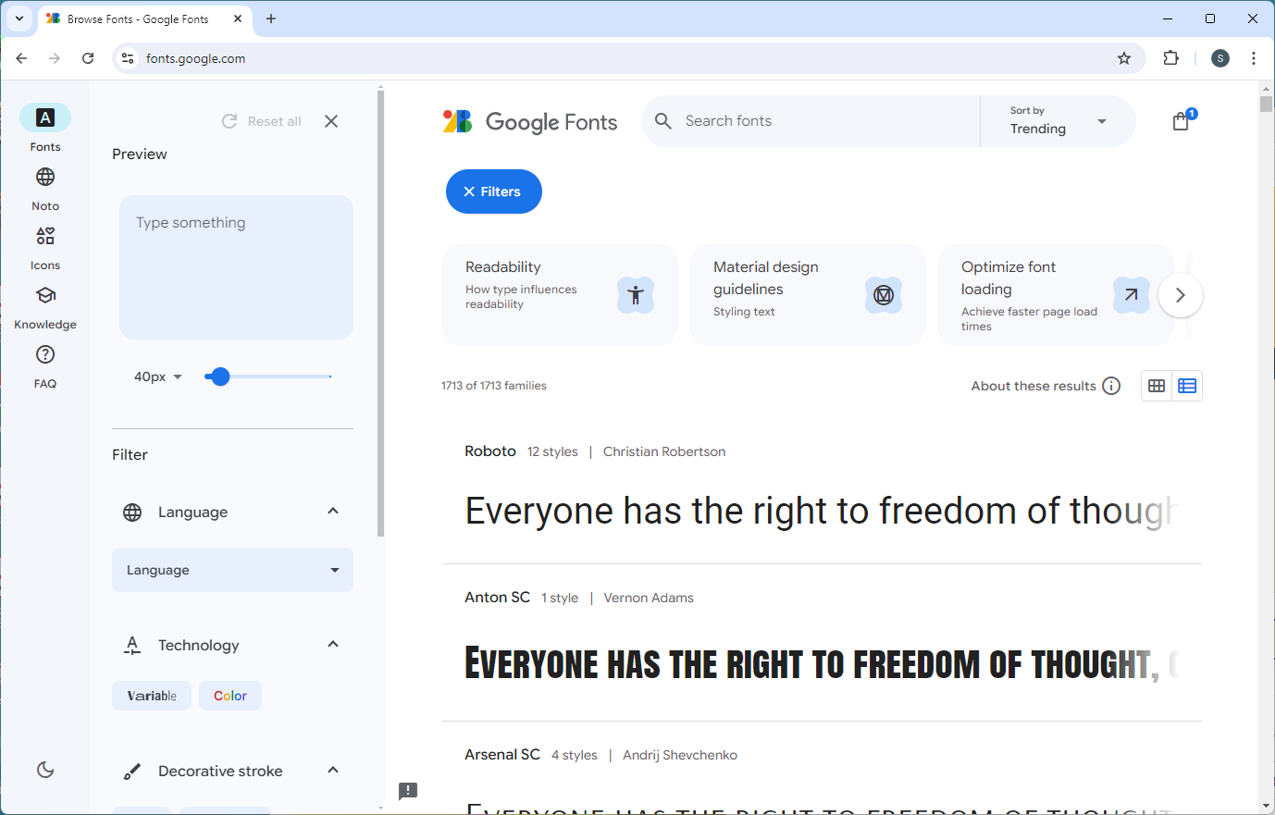
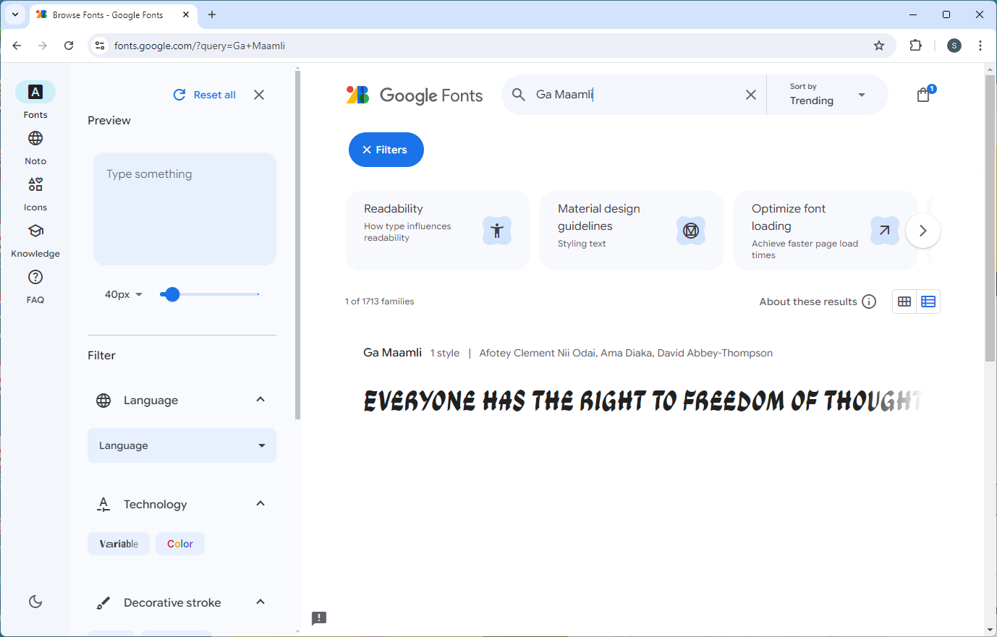
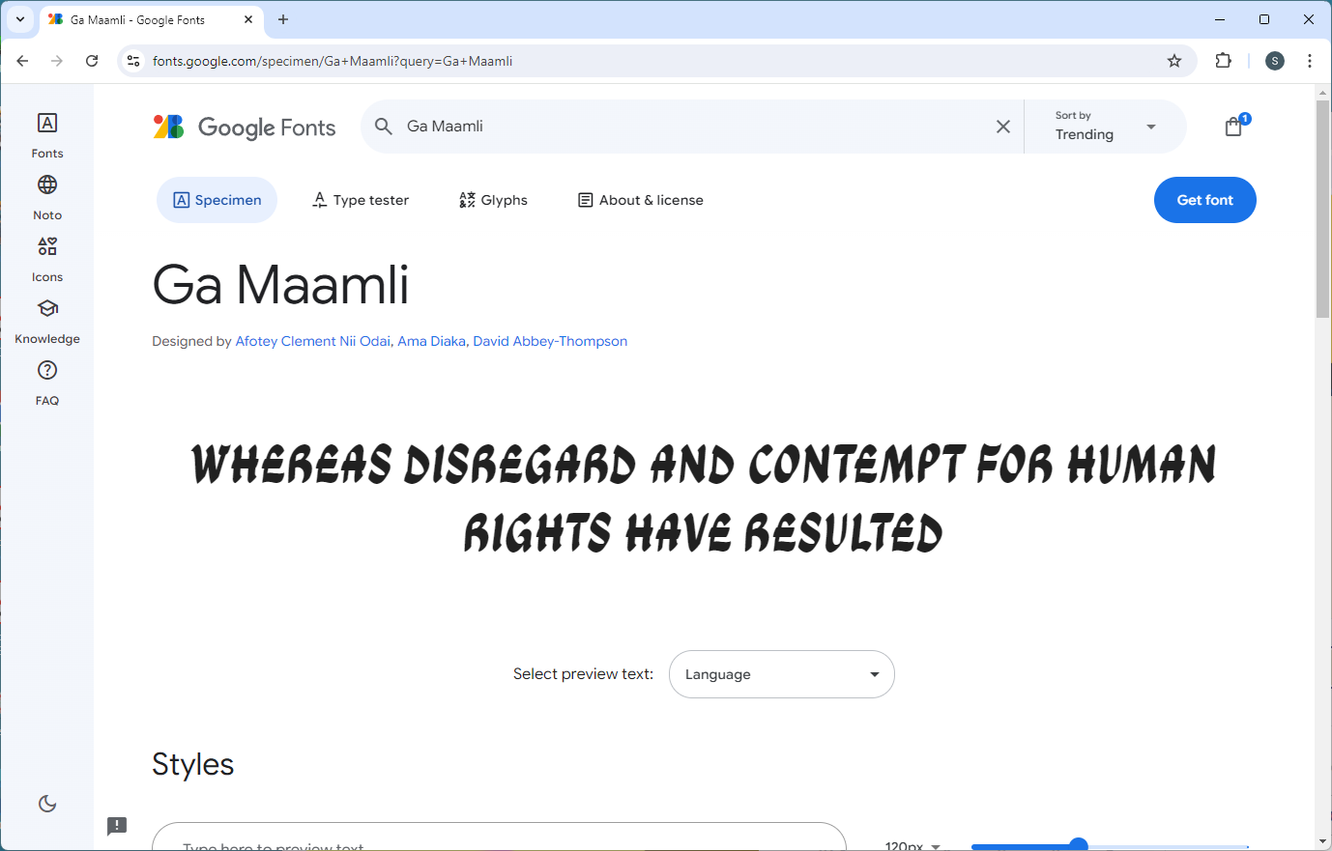
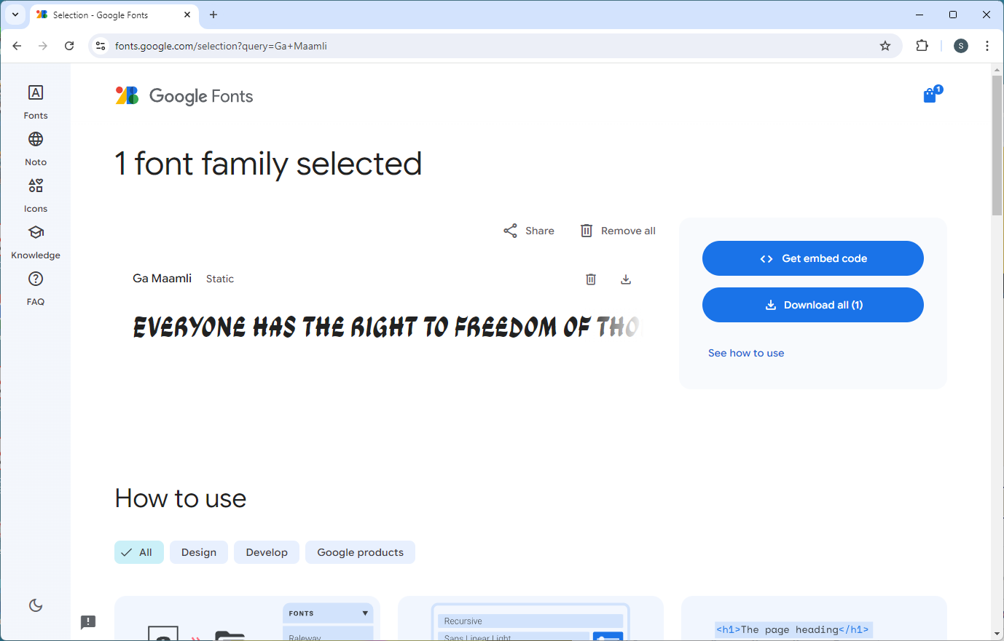
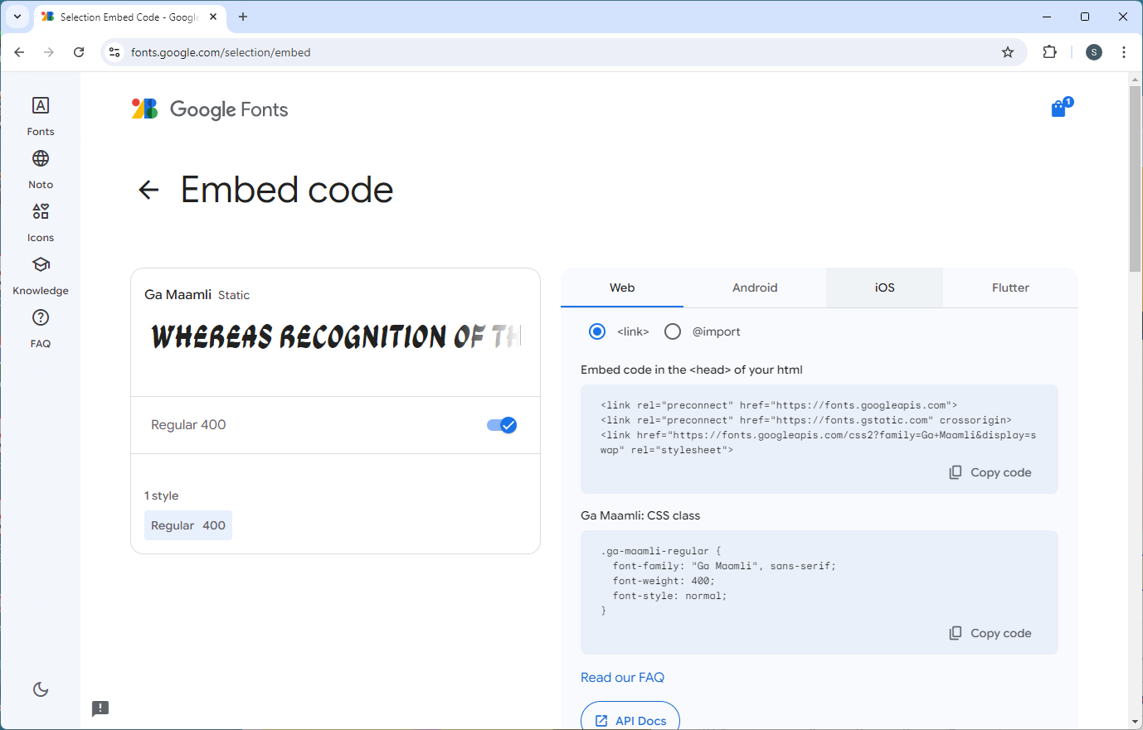
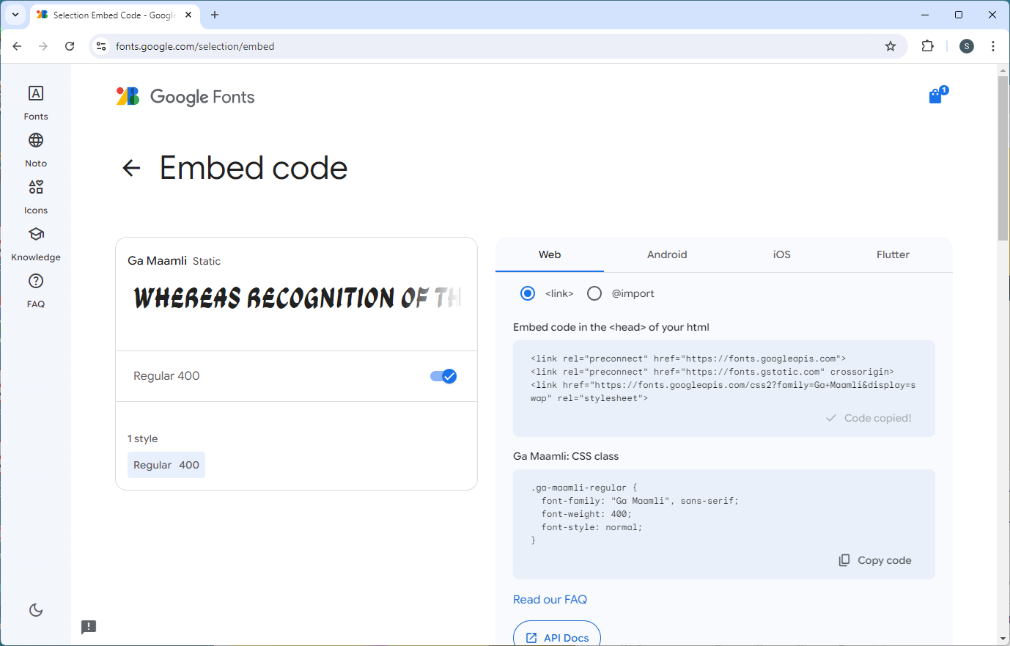
Dinosaur: Create the Template Page
Go to fonts.google.com
Find ‘Ga Maamli’ and ‘Get font’
Get the Embed Code; copy 3 links into <head> of index
5

Slide 6
Dinosaur: Create the Template Page
Paste in 3 links:
<!doctype html>
<html lang="en">
<head>
<meta charset="utf-8">
<title>Steve Johnson Dinosaur Assignment</title>
<link href="css/styles.css" rel="stylesheet">
</head>
<!doctype html>
<html lang="en">
<head>
<meta charset="utf-8">
<title>Steve Johnson Dinosaur Assignment</title>
<link href="css/styles.css" rel="stylesheet">
<link rel="preconnect" href="https://fonts.googleapis.com">
<link rel="preconnect" href="https://fonts.gstatic.com" crossorigin>
<link href="https://fonts.googleapis.com/css2?family=Ga+Maamli&display=swap"
rel="stylesheet">
</head>
6

Slide 7
Dinosaur: Create the Template Page
Go to fonts.google.com
Find ‘Fira Sans’ and ‘Get font’
Get the Embed Code; copy 3 links into <head> of index
7

Slide 8
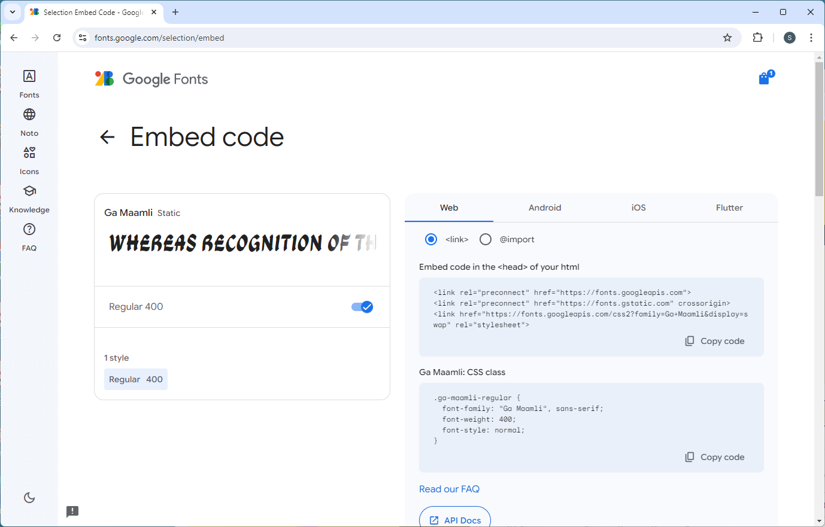
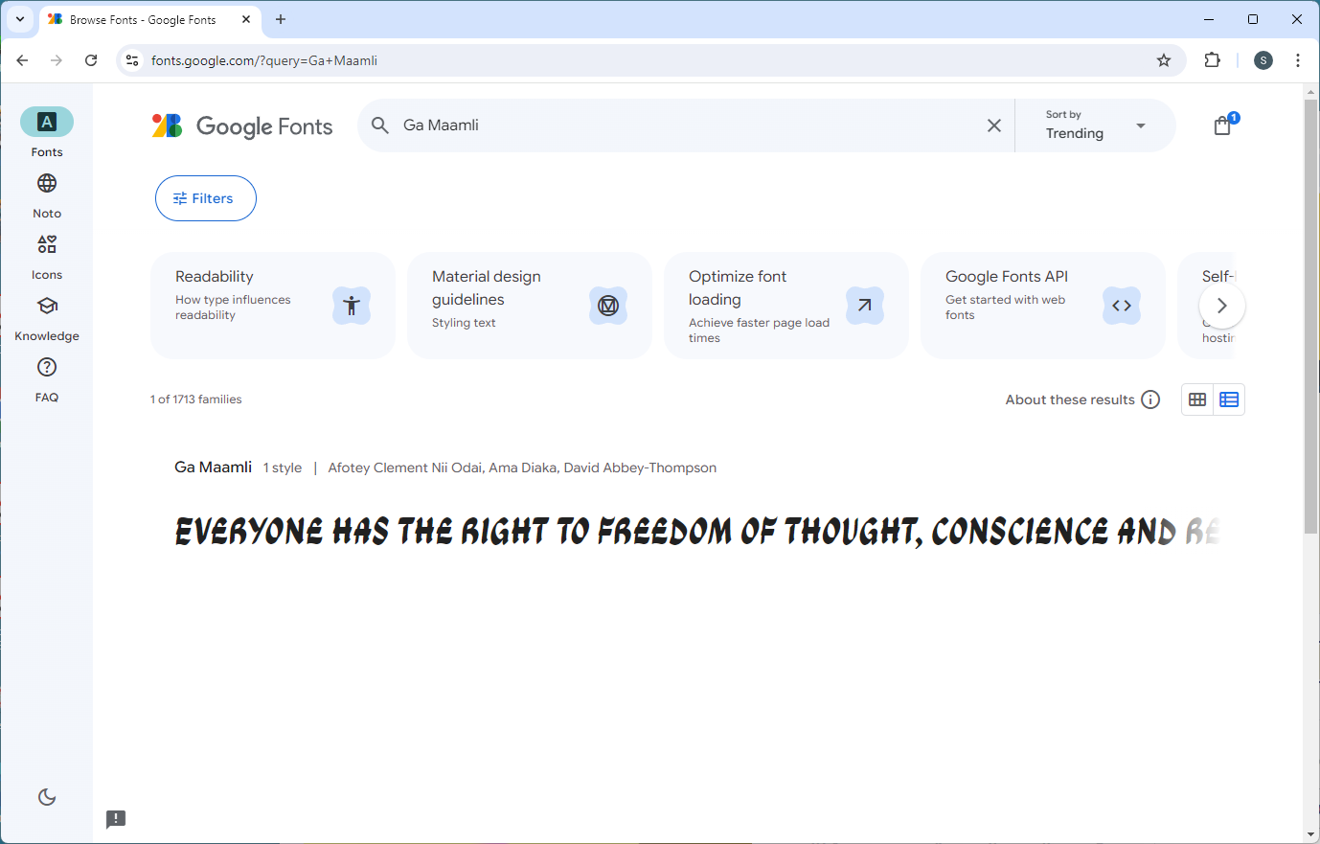
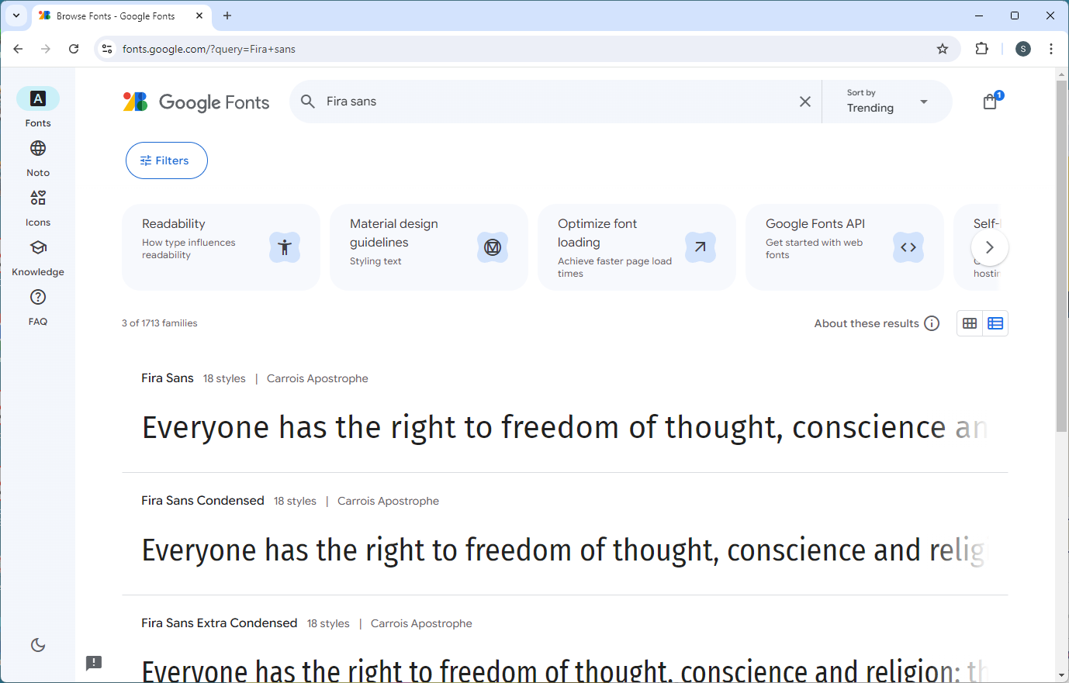
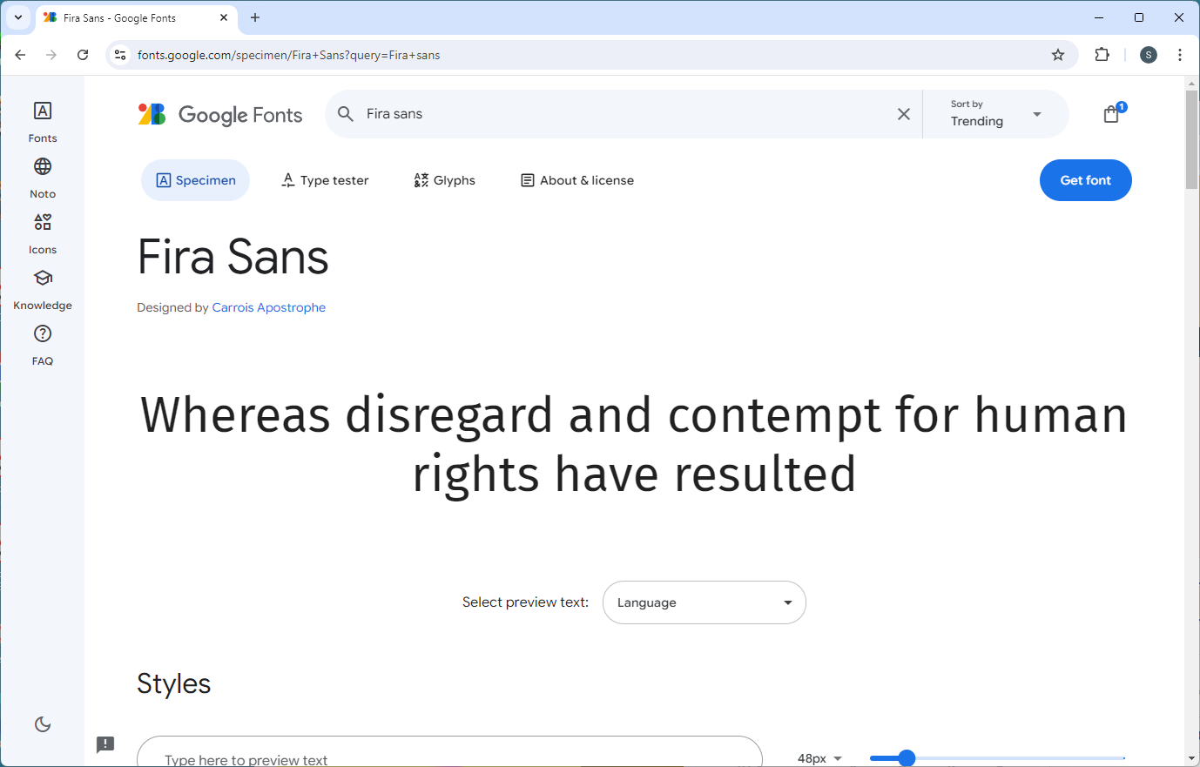
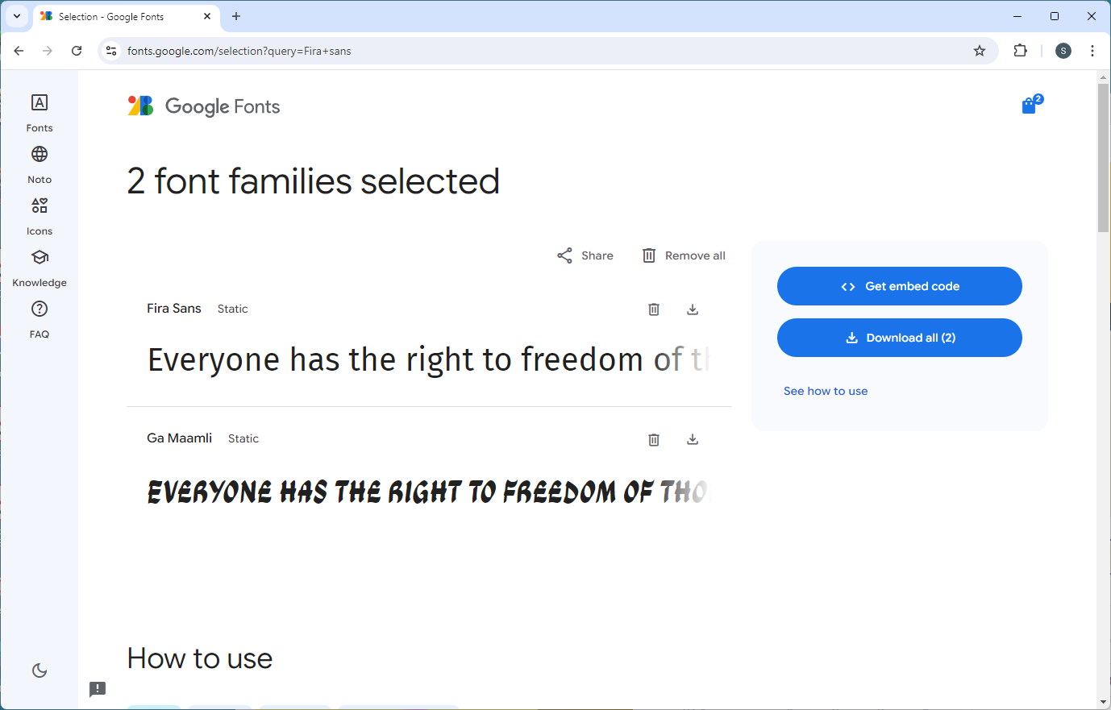
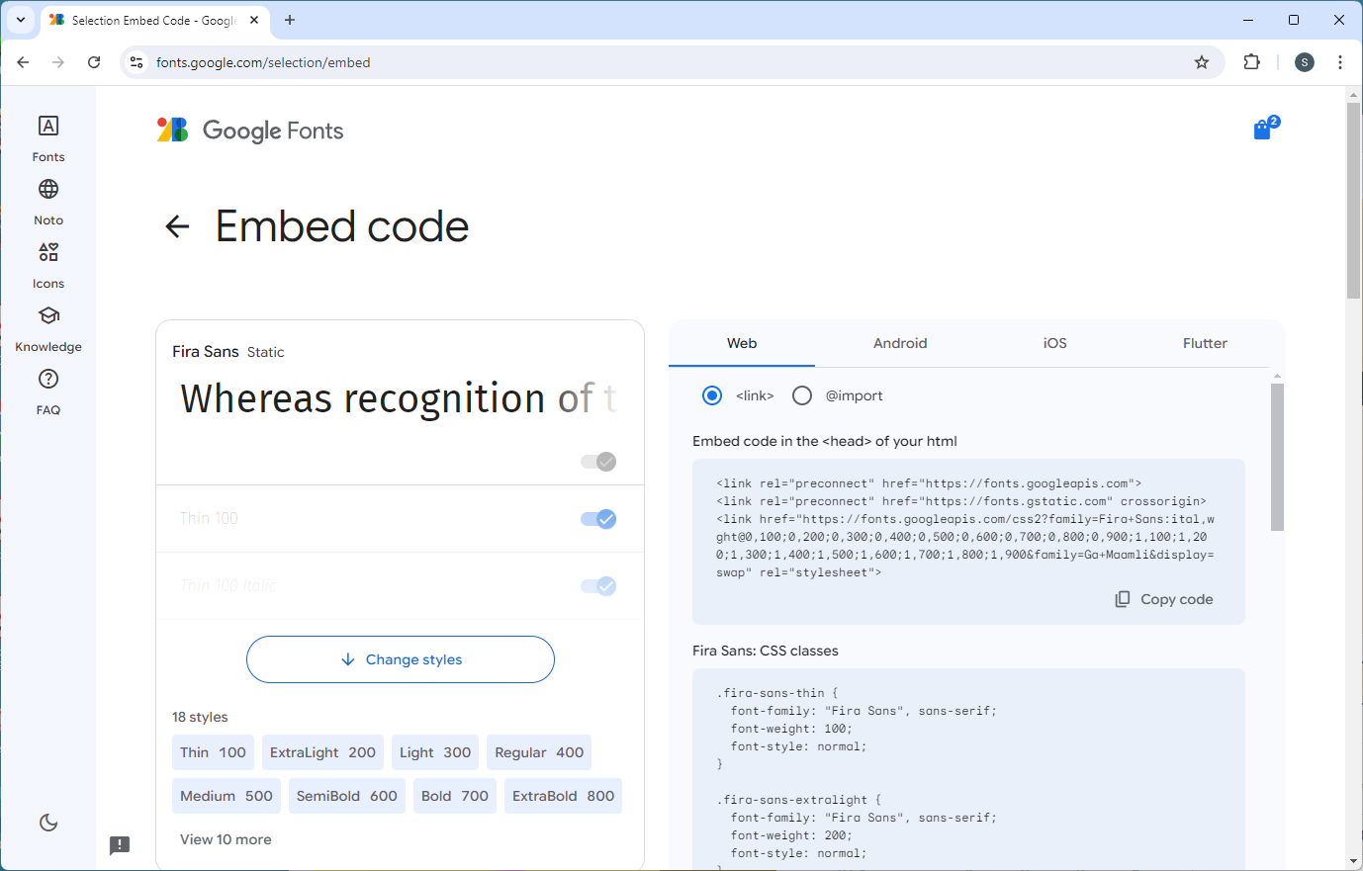

Dinosaur: Create the Template Page
8

Slide 9
Dinosaur: Create the Template Page
Paste in 3 links:
<!doctype html>
<html lang="en">
<head>
<meta charset="utf-8">
<title>Steve Johnson Dinosaur Assignment</title>
<link href="css/styles.css" rel="stylesheet">
<link rel="preconnect" href="https://fonts.googleapis.com">
<link rel="preconnect" href="https://fonts.gstatic.com" crossorigin>
<link href="https://fonts.googleapis.com/css2?family=Ga+Maamli&display=swap"
rel="stylesheet">
<link rel="preconnect" href="https://fonts.googleapis.com">
<link rel="preconnect" href="https://fonts.gstatic.com" crossorigin>
<link href="https://fonts.googleapis.com/css2?family=Fira+Sans:ital,wght@0,100;
0,200;0,300;0,400;0,500;0,600;0,700;0,800;0,900;1,100;1,200;1,300;1,400;
1,500;1,600;1,700;1,800;1,900&family=Ga+Maamli&display=swap" rel="stylesheet">
</head>
<!doctype html>
<html lang="en">
<head>
<meta charset="utf-8">
<title>Steve Johnson Dinosaur Assignment</title>
<link href="css/styles.css" rel="stylesheet">
<link rel="preconnect" href="https://fonts.googleapis.com">
<link rel="preconnect" href="https://fonts.gstatic.com" crossorigin>
<link href="https://fonts.googleapis.com/css2?family=Ga+Maamli&display=swap"
rel="stylesheet">
</head>
9

Slide 10
Dinosaur: Create the Template Page
Write the style for <body>
@charset "utf-8";
/* CSS Document */
body {
background: #fbf5de;
background-image: url('../images/hfootprint.png');
background-repeat: repeat-x;
}
@charset "utf-8";
/* CSS Document */
body {
background: #fbf5de;
background-image: url('../images/hfootprint.png');
background-repeat: repeat-x;
font-family: "Fira Sans", sans-serif;
font-weight: 300;
font-style: normal;
line-height: 1.3;
}
10

Slide 11
Dinosaur: Create the Template Page
Write the style for <main>
@charset "utf-8";
/* CSS Document */
body {
background: #fbf5de;
font-family: "Fira Sans", sans-serif;
font-weight: 300;
font-style: normal;
line-height: 1.3;
}
body {
background: #fbf5de;
font-family: "Fira Sans", sans-serif;
font-weight: 300;
font-style: normal;
line-height: 1.3;
}
main {
min-width: 50em;
max-width: 80em;
width: calc(100% - 1em – 2px);
background: radial-gradient(#f8f0de 0%, #f8f0de 50%, #e1dac0 95%);
padding: 0 .5em .5em;
margin: 6em auto 1em;
border: 1px solid black;
border-radius: .5em;
}
11

Slide 12
Dinosaur: Create the Template Page
Write the style for <h1>
main {
min-width: 50em;
max-width: 80em;
width: calc(100% - 1em);
background: radial-gradient(#f8f0de 0%, #f8f0de 50%, #e1dac0 95%);
padding: 0 .5em .5em;
margin: 1em auto;
}
header {
background: #d7d1bc;
padding: 1em;
}
main {
min-width: 50em;
max-width: 80em;
width: calc(100% - 1em);
background: radial-gradient(#f8f0de 0%, #f8f0de 50%, #e1dac0 95%);
padding: 0 .5em .5em;
margin: 1em auto;
}
12

Slide 13
Dinosaur: Create the Template Page
Write the style for <h1>
header {
background: #d7d1bc;
padding: 1em;
}
h1, h2 {
font-family: "Ga Maamli", sans-serif;
font-weight: 100;
margin: 0;
font-style: normal;
}
h1 {
font-size: 3em;
text-align: center;
}
h2 {
font-size: 2em;
}
header {
background: #d7d1bc;
padding: 1em;
}
13

Slide 14
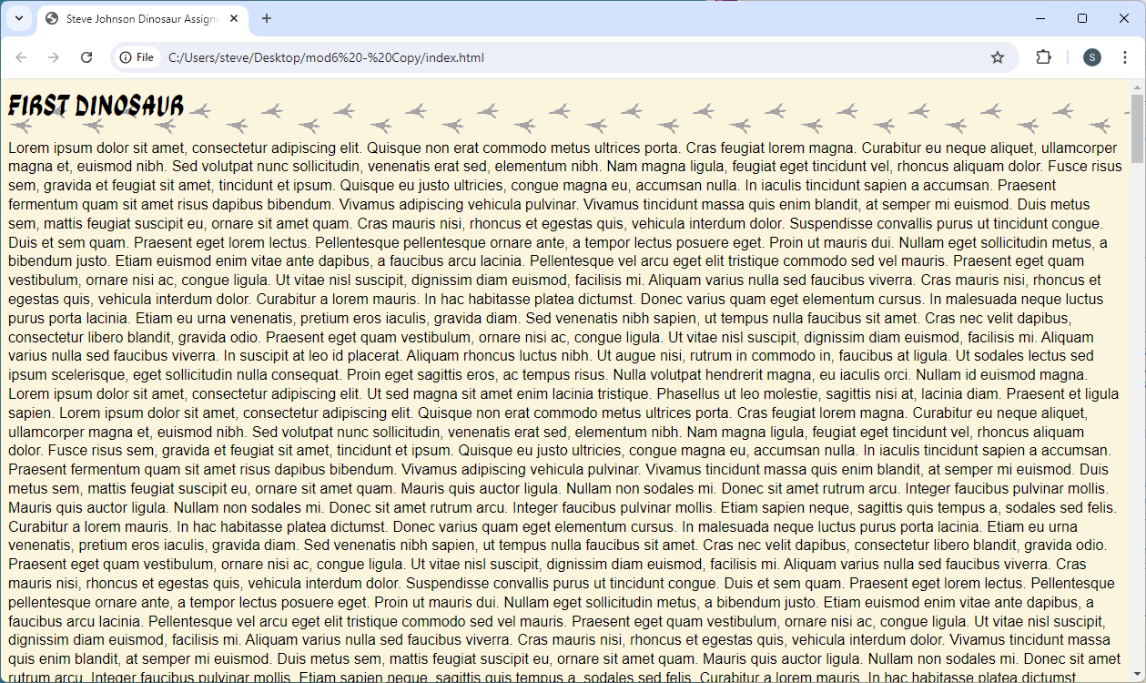
Dinosaur: Create the Template Page
Save both pages, view in browser
14

Slide 15
Dinosaur: Create the Template Page
Create <main> and <header> elements
Add <h1> text: My Dinosaurs
</head>
<body>
<main>
<header>
<h1>My Dinosaur Assignment</h1>
</header>
<article>
<h2>First Dinosaur</h2>
</main>
</head>
<body>
<article>
<h2>First Dinosaur</h2>
15

Slide 16
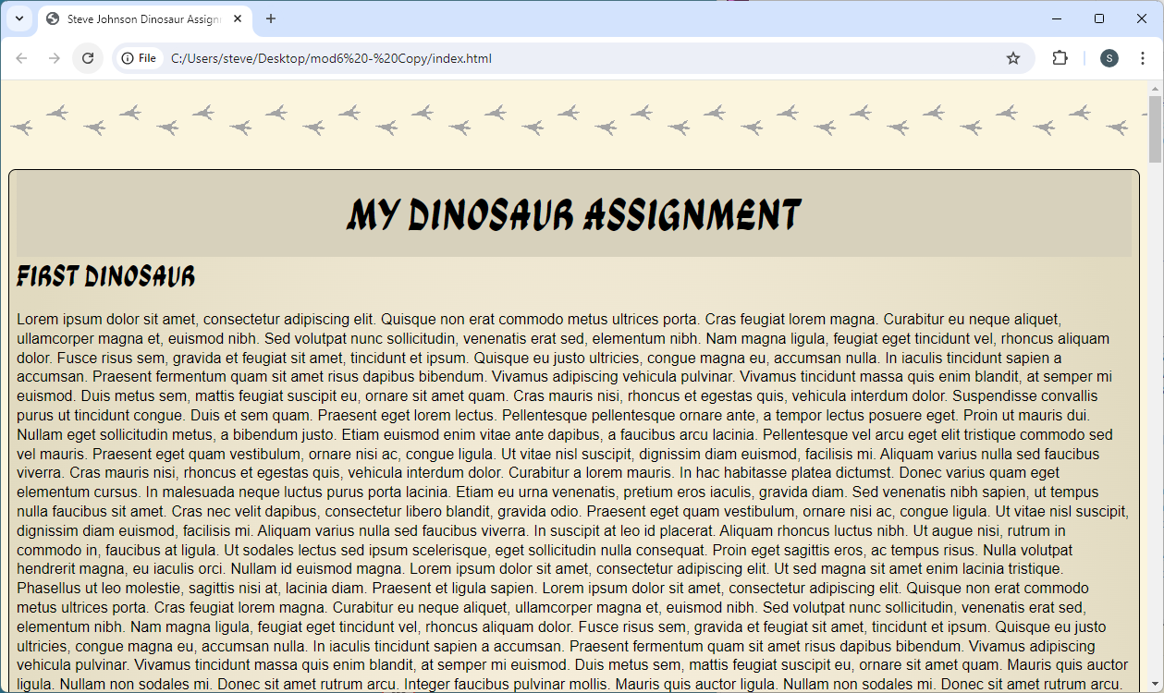
Dinosaur: Create the Template Page
Save ‘index’, view in browser
16

Slide 17
Dinosaur: Create the Template Page
Create <nav> under <header>
</head>
<body>
<header>
<h1>My Dinosaur Assignment</h1>
</header>
<article>
<h2>First Dinosaur</h2>
</head>
<body>
<header>
<h1>My Dinosaur Assignment</h1>
</header>
<nav>
<ul>
<li>Home</li>
<li>Triceratops</li>
<li>Stegosaurus</li>
<li>Archaeopteryx</li>
<li>Brontosaurus</li>
</ul>
</nav>
<article>
<h2>First Dinosaur</h2>
17

Slide 18
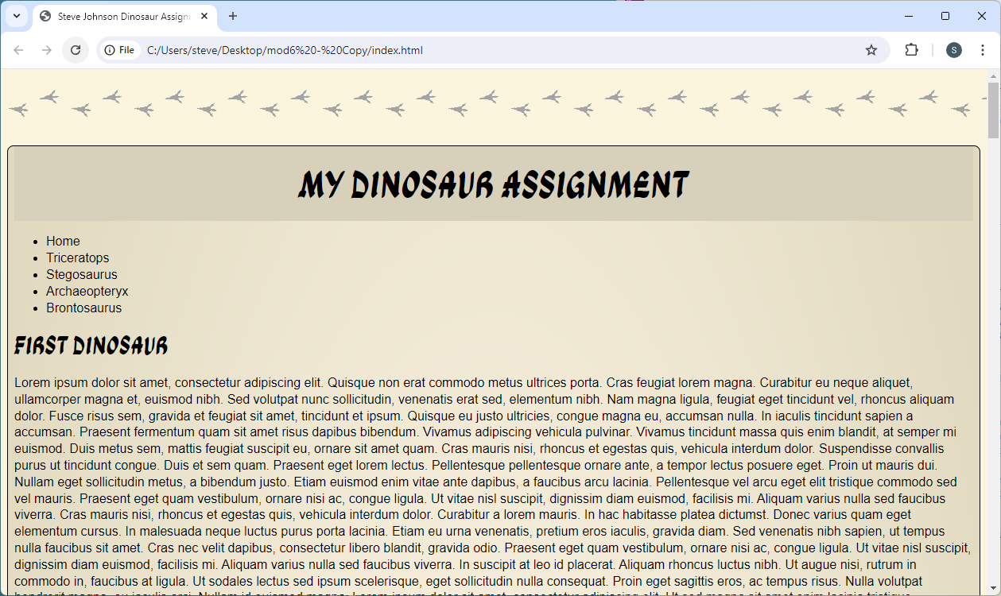
Dinosaur: Create the Template Page
Save ‘index’, view in browser
18

Slide 19
Dinosaur: Create the Template Page
Style the <nav> and <ul>
h1 {
font-family: "Ga Maamli", sans-serif;
font-weight: 100;
font-size: 3em;
margin: 0;
font-style: normal;
text-align: center;
}
nav {
overflow: auto;
margin-bottom: 1em;
}
ul {
margin: 0;
padding: 0;
list-style-type: none;
}
h1 {
font-family: "Ga Maamli", sans-serif;
font-weight: 100;
font-size: 3em;
margin: 0;
font-style: normal;
text-align: center;
}
19

Slide 20
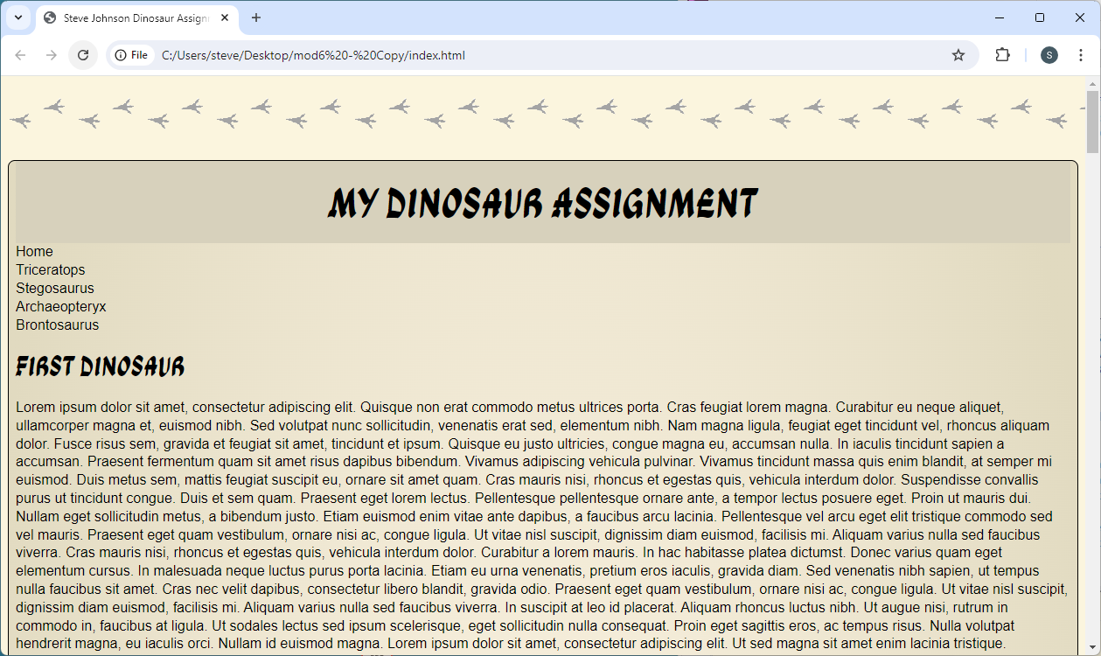
Dinosaur: Create the Template Page
Save both pages, view in browser
20

Slide 21
Dinosaur: Create the Template Page
Style the <li>
ul {
margin: 0;
padding: 0;
list-style-type: none;
}
ul {
margin: 0;
padding: 0;
list-style-type: none;
}
li {
background: #d7d1bc;
float: left;
width: calc(20% - 2px);
text-align: center;
border-left: 1px solid #f8f0de;
border-right: 1px solid black;
height: 2em;
padding-top: .75em;
font-family: "Ga Maamli", sans-serif;
font-weight: 100;
}
21

Slide 22
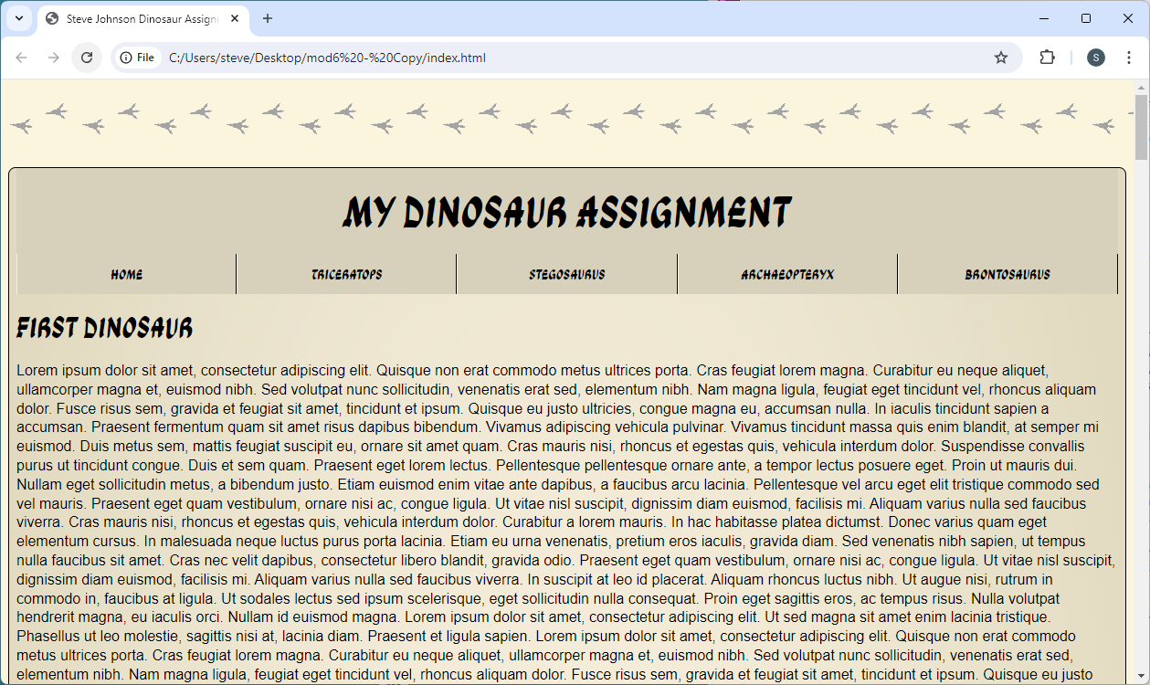
Dinosaur: Create the Template Page
Save both pages, view in browser
22

Slide 23
Dinosaur: Create the Template Page
Style the ends of the list
li {
background: #d7d1bc;
float: left;
width: calc(20% - 2px);
text-align: center;
border-left: 1px solid #f8f0de;
border-right: 1px solid black;
height: 2em;
padding-top: .75em;
font-family: "Ga Maamli", sans-serif;
font-weight: 100;
}
li:first-child {
border-left: 1px solid #d7d1bc;
}
li:last-child {
border-right: 1px solid #d7d1bc;
}
li {
background: #d7d1bc;
float: left;
width: calc(20% - 2px);
text-align: center;
border-left: 1px solid #f8f0de;
border-right: 1px solid black;
height: 2em;
padding-top: .75em;
font-family: "Ga Maamli", sans-serif;
font-weight: 100;
}
23

Slide 24

Dinosaur: Create the Template Page
Save both pages, view in browser
24

Slide 25
Dinosaur: Create the Template Page
Change background color on ‘hover’
li:last-child {
border-right: 1px solid #d7d1bc;
}
li:hover {
background: #c2bdaa;
cursor: pointer;
}
li:last-child {
border-right: 1px solid #d7d1bc;
}
25

Slide 26
Dinosaur: Create the Template Page
Add the links for the coming pages:
<nav>
<ul>
<li>Home</li>
<li><a href="page2.html">Triceratops</a></li>
<li><a href="page3.html">Stegosaurus</a></li>
<li><a href="page4.html">Archaeopteryx</a></li>
<li><a href="page5.html">Brontosaurus</a></li>
</ul>
</nav>
<article>
<nav>
<ul>
<li>Home</li>
<li>Triceratops</li>
<li>Stegosaurus</li>
<li>Archaeopteryx</li>
<li>Brontosaurus</li>
</ul>
</nav>
<article>
26

Slide 27
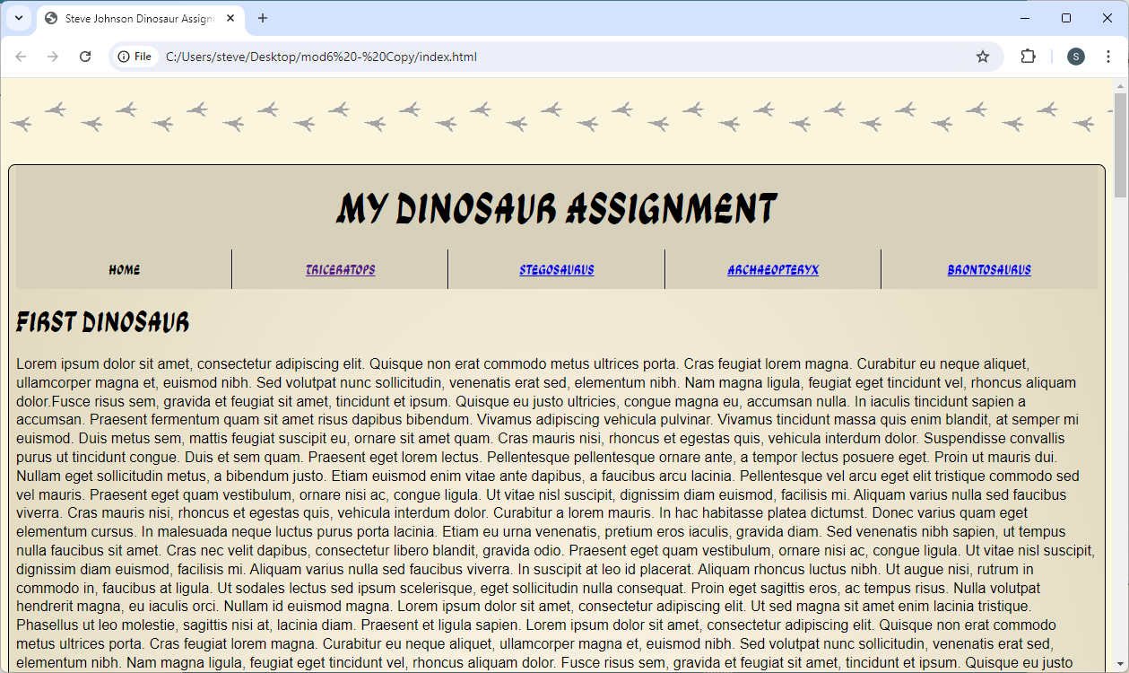
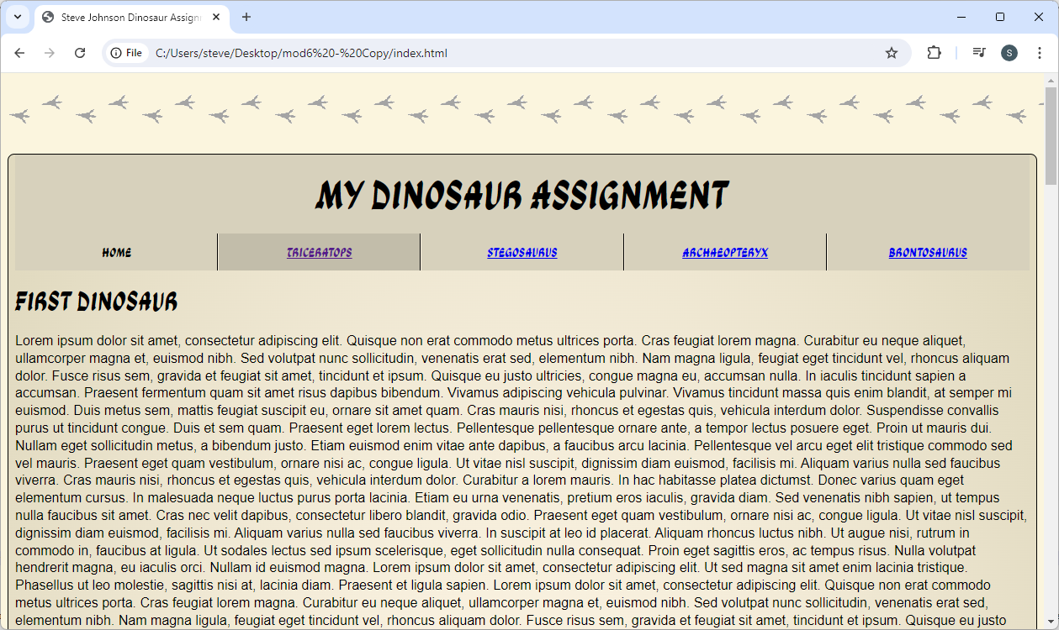
Dinosaur: Create the Template Page
Save both pages, view in browser
27

Slide 28
Dinosaur: Create the Template Page
Place ‘indexpix’ in <p> between </nav> and <article>
<nav>
<ul>
<li>Home</li>
<li><a href="page2.html">Triceratops</a></li>
<li><a href="page3.html">Stegosaurus</a></li>
<li><a href="page4.html">Archaeopteryx</a></li>
<li><a href="page5.html">Brontosaurus</a></li>
</ul>
</nav>
<p id="pix"><img src="images/indexpix.png" width="400" height="247" id="titlepix" alt="Pterodactyl flying against a sun" title="Pterodactyls coming to my site!"></p>
<article>
<nav>
<ul>
<li>Home</li>
<li><a href="page2.html">Triceratops</a></li>
<li><a href="page3.html">Stegosaurus</a></li>
<li><a href="page4.html">Archaeopteryx</a></li>
<li><a href="page5.html">Brontosaurus</a></li>
</ul>
</nav>
<article>
28

Slide 29
Dinosaur: Create the Template Page
Center image as a block element:
li:hover {
background: #c2bdaa;
cursor: pointer;
}
#titlepix {
display: block;
margin: 2em auto;
width: 33%;
height: auto;
}
li:hover {
background: #c2bdaa;
cursor: pointer;
}
29

Slide 30
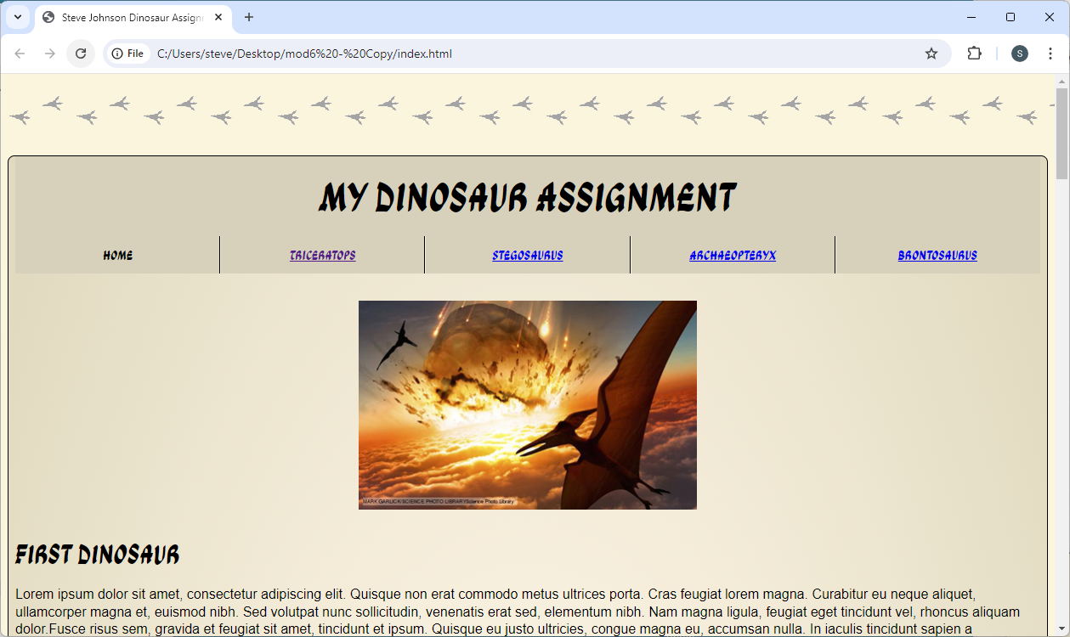
Dinosaur: Create the Template Page
Save both pages, view in browser
30

Slide 31
Dinosaur: Create the Template Page
Place ‘para1’ image somewhere in first paragraph
Place ‘para2’ image somewhere in the second paragraph
Place ‘para3’ image somewhere in the third paragraph
sit amet rutrum arcu. Integer faucibus pulvinar mollis.<img class="left" src="images/para1.png" width="310" height="332" alt="Terrible Lizard" title="I am always hungry!">Mauris quis auctor ligula. Nullam non sodales mi.
sit amet rutrum arcu. Integer faucibus pulvinar mollis.<img class="right" src="images/para2.png" width="750" height="794" alt="Terrible Lizard" title="I am very noisy!">Mauris quis auctor ligula. Nullam non sodales mi.
sit amet rutrum arcu. Integer faucibus pulvinar mollis.<img class="left" src="images/para3.png" width="675" height="748" alt="Brontosaurus" title="Tree tops are very tasty!">Mauris quis auctor ligula. Nullam non sodales mi.
31

Slide 32
Dinosaur: Create the Template Page
Float the images and resize:
#titlepix {
display: block;
margin: 2em auto;
width: 33%;
height: auto;
}
.left {
float: left;
width: 25%;
height: auto;
margin-right: .5em;
margin-bottom: .5em;
}
.right {
float: right;
width: 25%;
height: auto;
margin-left: .5em;
margin-bottom: .5em;
}
32

Slide 33
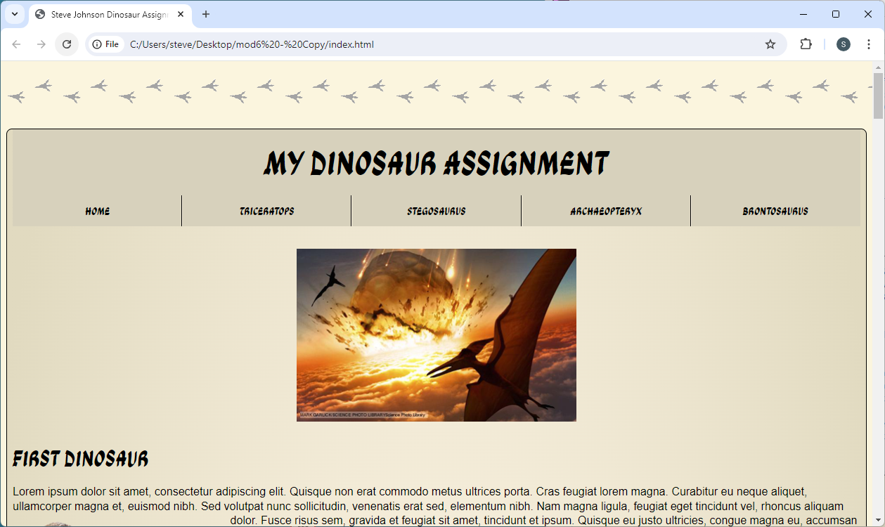
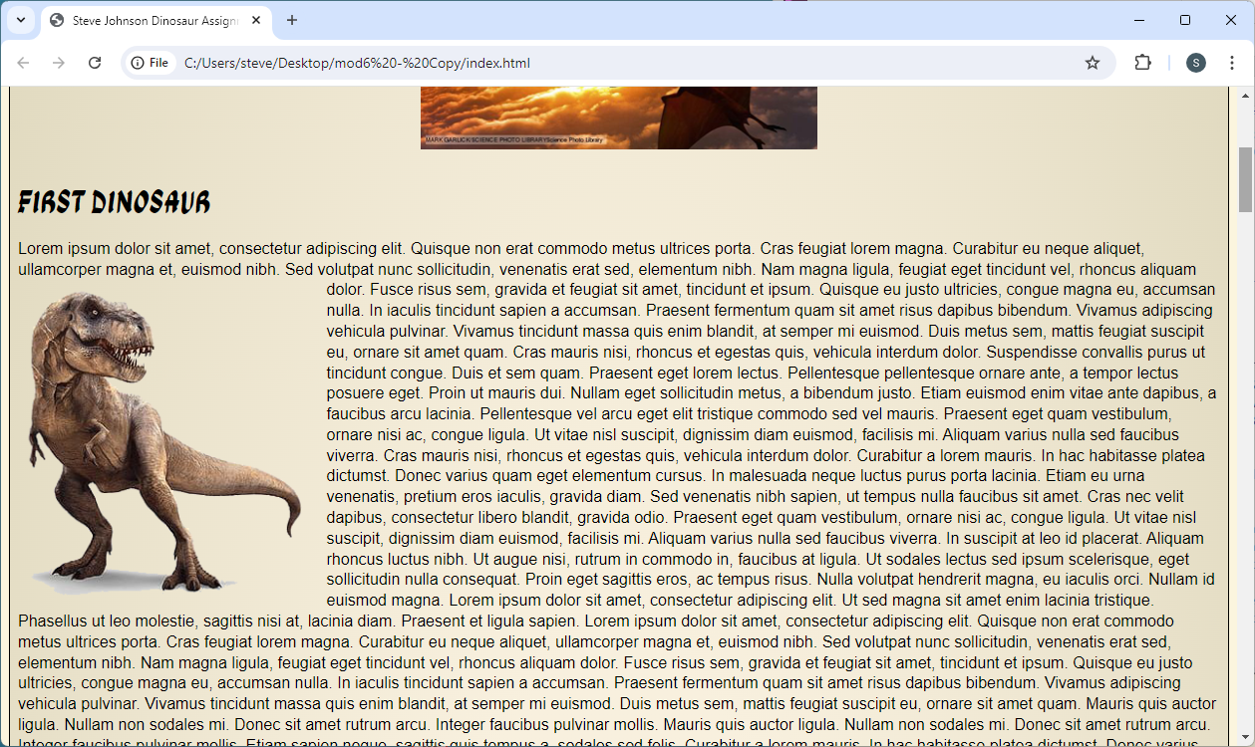
Dinosaur: Create the Template Page
Save both pages, view in browser
33

Slide 34
Dinosaur: Create the Template Page
Add an id to <article> for paragraph 2
Link to open at the second paragraph
<article>
<article id="para2">
<p><a href="index.html#para2">Go to Paragraph 2</a></p>
<p>Go to Paragraph 2</p>
34

Slide 35
Dinosaur: Create the Template Page
Add the links at the bottom
</article>
<footer>
<p><a href="https://dinosaurs.com">Go to Dinosaurs.com</a></p>
<p>Email: <a href="mailto:danny.dinosaur@dinosaur.com">Danny Dinosaur</a></p>
<p>Phone: <a href="tel:+3521234567">(352) 123-4567</a></p>
<p><a href="index.html#para2">Go to Paragraph 2</a></p>
<p><a href="page2.html" target="_blank">Open next page in new window</a></p>
</footer>
</main>
</article>
<footer>
<p>Dinosaurs.com</p>
<p>Email Danny Dinosaur</p>
<p>Phone:</p>
<p>Go to Paragraph 2</p>
<p>open next page in new window</p>
</footer>
</main>
35

Slide 36
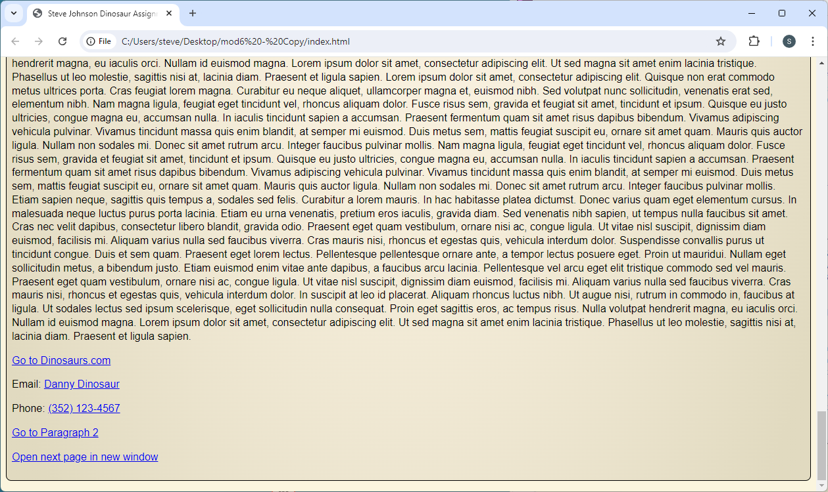
Dinosaur: Create the Template Page
Save both pages, view in browser
36

Slide 37
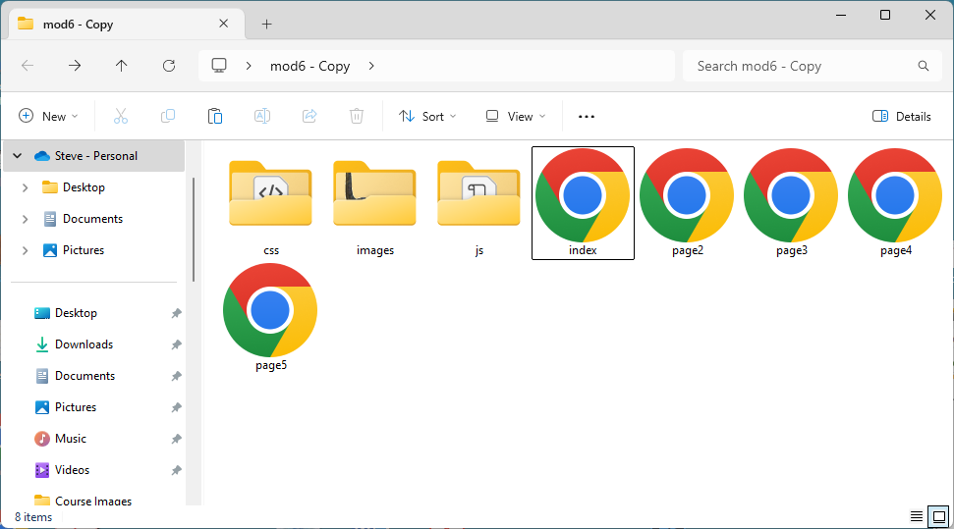
Dinosaur: Copy & Paste
Close ‘index’ and ‘styles’
Make four copies named: page2, page3, page4, page5.html
Place copied pages in same folder as ‘index’
37

Slide 38

Dinosaur
All pathways remain the same
page2.html
page3.html
css
js
images
index.html
page4.html
styles.css
<link href="css/styles.css" rel="stylesheet">
page5.html
38

Slide 39
Dinosaur: Copy & Paste
Open ‘page2.html’. Fix dead link in the <nav> of page2:
<nav>
<ul>
<li><a href="index.html">Home</a></li>
<li>Triceratops</li>
<li><a href="page3.html">Stegosaurus</a></li>
<li><a href="page4.html">Archaeopteryx</a></li>
<li><a href="page5.html">Brontosaurus</a></li>
</ul>
</nav>
<nav>
<ul>
<li>Home</li>
<li><a href="page2.html">Triceratops</a></li>
<li><a href="page3.html">Stegosaurus</a></li>
<li><a href="page4.html">Archaeopteryx</a></li>
<li><a href="page5.html">Brontosaurus</a></li>
</ul>
</nav>
39

Slide 40
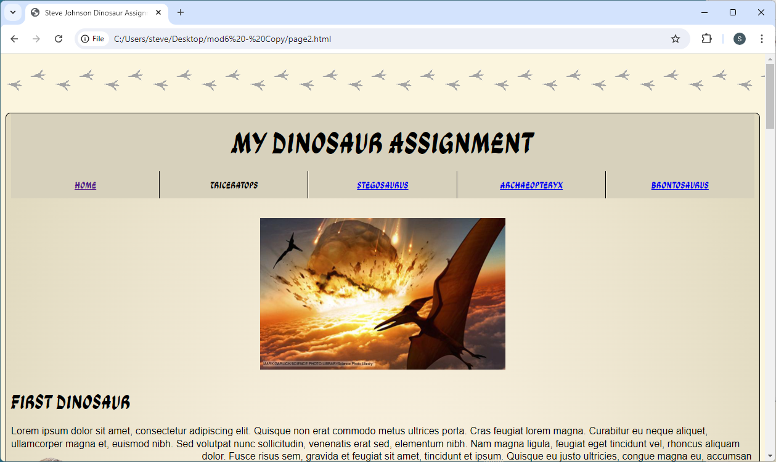
Dinosaur: Copy & Paste
Open ‘page2.html’. Fix dead link in the <nav> of page2:
40

Slide 41
Dinosaur: Copy & Paste
Change the anchor link to page2 and next page to page3:
<footer>
<p><a href="https://dinosaurs.com">Go to Dinosaurs.com</a></p>
<p>Email: <a href="mailto:danny.dinosaur@dinosaur.com">Danny Dinosaur</a></p>
<p>Phone: <a href="tel:+3521234567">(352) 123-4567</a></p>
<p><a href="page2.html#para2">Go to Paragraph 2</a></p>
<p><a href="page3.html" target="_blank">Open next page in new window</a></p>
</footer>
<footer>
<p><a href="https://dinosaurs.com">Go to Dinosaurs.com</a></p>
<p>Email: <a href="mailto:danny.dinosaur@dinosaur.com">Danny Dinosaur</a></p>
<p>Phone: <a href="tel:+3521234567">(352) 123-4567</a></p>
<p><a href="index.html#para2">Go to Paragraph 2</a></p>
<p><a href="page2.html" target="_blank">Open next page in new window</a></p>
</footer>
41

Slide 42
Dinosaur: Copy & Paste
Page3 fixes:
<nav>
<ul>
<li><a href="index.html">Home</a></li>
<li><a href="page2.html">Triceratops</a></li>
<li>Stegosaurus</li>
<li><a href="page4.html">Archaeopteryx</a></li>
<li><a href="page5.html">Brontosaurus</a></li>
</ul>
</nav>
<footer>
<p><a href="https://dinosaurs.com">Go to Dinosaurs.com</a></p>
<p>Email: <a href="mailto:danny.dinosaur@dinosaur.com">Danny Dinosaur</a></p>
<p>Phone: <a href="tel:+3521234567">(352) 123-4567</a></p>
<p><a href="page3.html#para2">Go to Paragraph 2</a></p>
<p><a href="page4.html" target="_blank">Open next page in new window</a></p>
</footer>
42

Slide 43
Dinosaur: Copy & Paste
Page4 fixes:
<nav>
<ul>
<li><a href="index.html">Home</a></li>
<li><a href="page2.html">Triceratops</a></li>
<li><a href="page3.html">Stegosaurus</a></li>
<li>Archaeopteryx</li>
<li><a href="page5.html">Brontosaurus</a></li>
</ul>
</nav>
<footer>
<p><a href="https://dinosaurs.com">Go to Dinosaurs.com</a></p>
<p>Email: <a href="mailto:danny.dinosaur@dinosaur.com">Danny Dinosaur</a></p>
<p>Phone: <a href="tel:+3521234567">(352) 123-4567</a></p>
<p><a href="page4.html#para2">Go to Paragraph 2</a></p>
<p><a href="page5.html" target="_blank">Open next page in new window</a></p>
</footer>
43

Slide 44
Dinosaur: Copy & Paste
Page5 fixes:
<nav>
<ul>
<li><a href="index.html">Home</a></li>
<li><a href="page2.html">Triceratops</a></li>
<li><a href="page3.html">Stegosaurus</a></li>
<li><a href="page4.html">Archaeopteryx</a></li>
<li>Brontosaurus</li>
</ul>
</nav>
<footer>
<p><a href="https://dinosaurs.com">Go to Dinosaurs.com</a></p>
<p>Email: <a href="mailto:danny.dinosaur@dinosaur.com">Danny Dinosaur</a></p>
<p>Phone: <a href="tel:+3521234567">(352) 123-4567</a></p>
<p><a href="page5.html#para2">Go to Paragraph 2</a></p>
<p><a href=“index.html" target="_blank">Open next page in new window</a></p>
</footer>
44

Slide 45
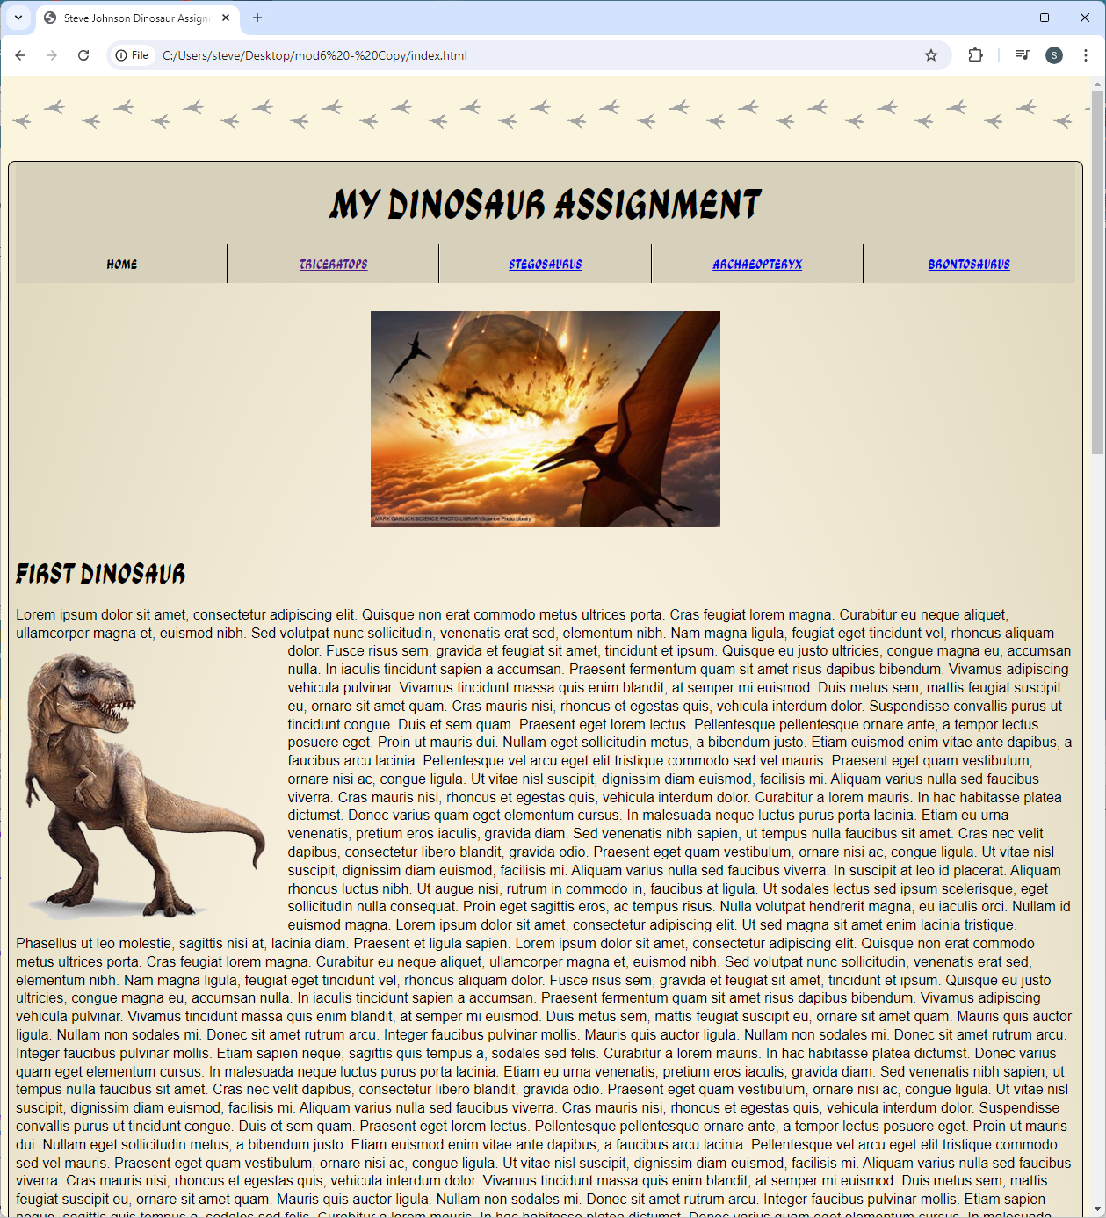
Dinosaur: Copy & Paste
Done!
45

